Slide 2
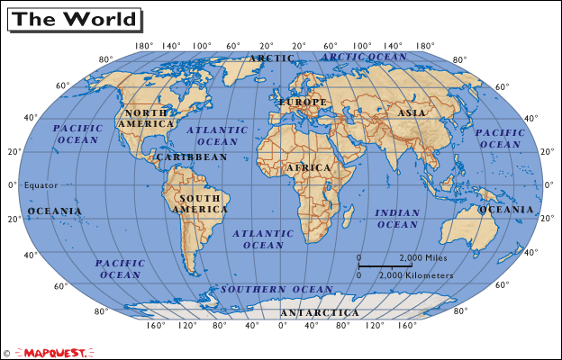
Page 16

Slide 3
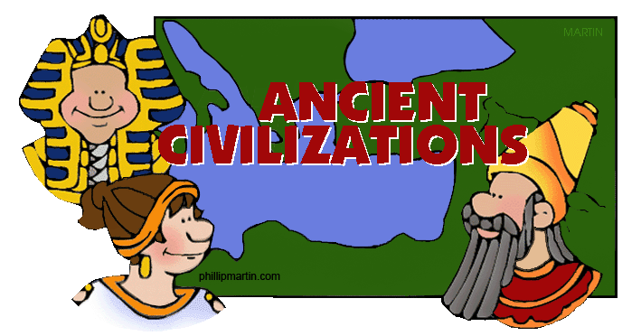
Early Farming Villages…
Developed into “Civilizations” which have:
Cities
Governments
Art
Religion
Class divisions
Writing system

Slide 4
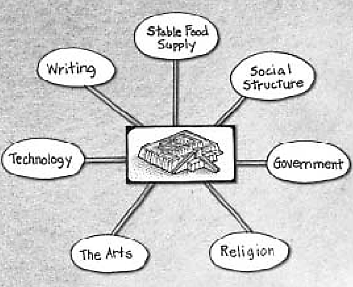

Slide 5
Where Did Civilization Develop?
Near water—especially along rivers.
Rivers provided water for farming
To grow food for a lot of people
Rivers allowed for transportation
Rivers allowed for trade
Rivers provided food—fishing

Slide 6
As Civilizations Grew…
Less time was needed for trying to get food. So, more time was available for putting up buildings, and
Developing works of art and architecture
Developing language and writing
Thinking about their faith (religion)
Some form of government was needed to organize all of this work.

Slide 7
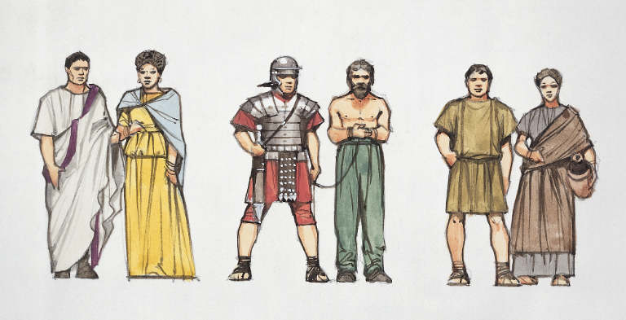

Slide 8
People of Sumer Were of Three Classes
Kings, Priests, Government Officials
Merchants, Farmers, Fishers
Enslaved People—worked on farms, and buildings

Slide 9
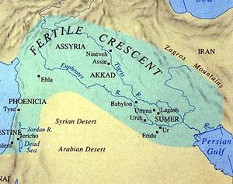
The Tigris and Euphrates Rivers were PERFECT for civilization to grow!

Slide 10
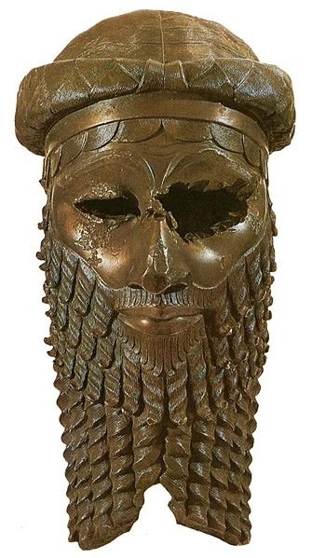
The Land
Between the Tigris and the Euphrates, in what is now southern Iraq,
became known as…
Mesopotamia
The First Civilization to Develop There was…
Sumeria

Slide 14
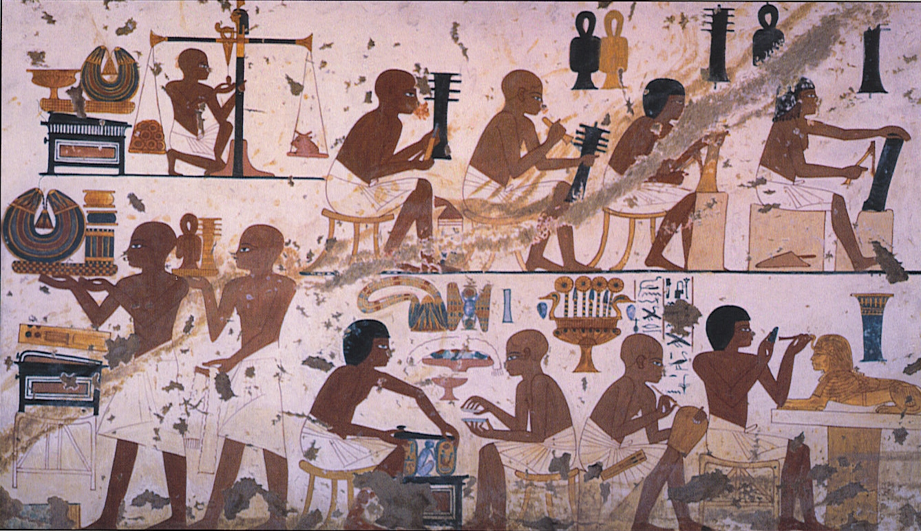
Life in Sumer—”Artisans”
Artisans—make things, out of metal, stone and brick, cloth, leather, jewels, etc.

Slide 15
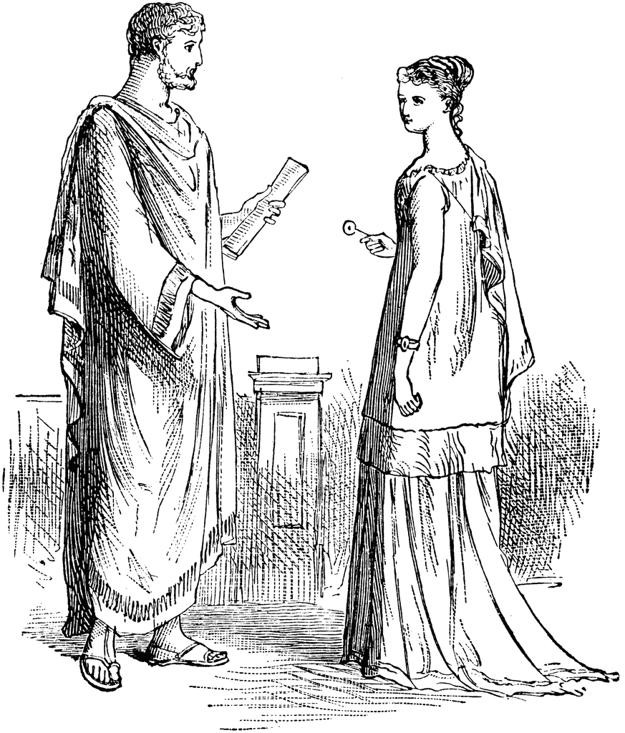
Men and Woman

Slide 16
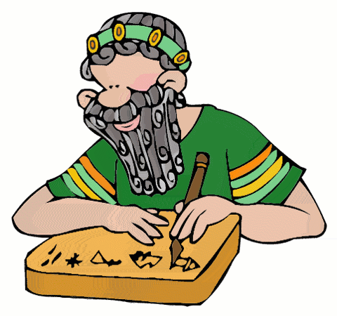
The Sumerians Gave Us Writing
One of the greatest gifts the Sumerians
left us was writing.
The Sumerians form of writing
was called Cuneiform

Slide 17
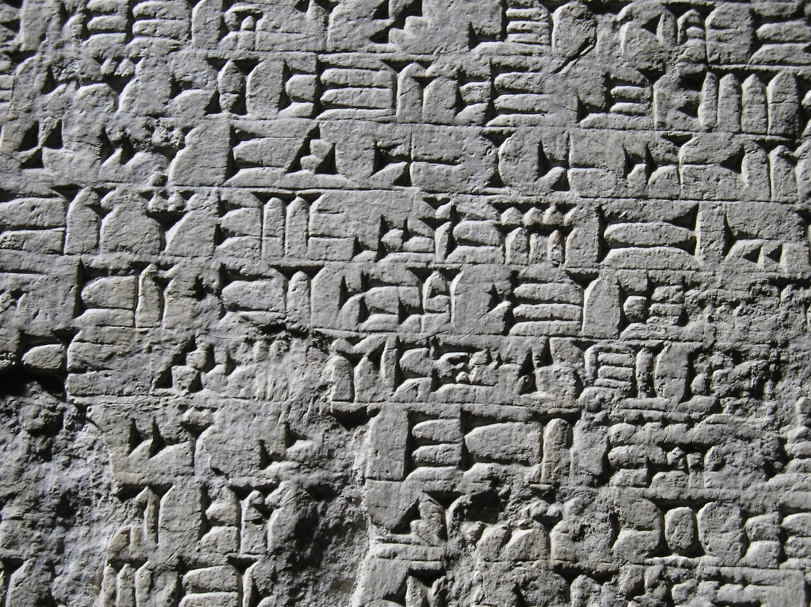
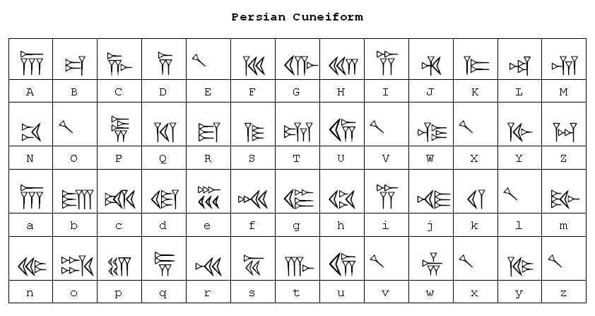
Cuneiform

Slide 18
Science and Mathematics
Sumerians gave us developments in Science:
The wheel
The plow
The sailboat
Sumerians gave us advances in Math:
Geometry
Astronomy
12 month calendar
“Base 60” math—for seconds and circles

Slide 21
Review Video
Ancient Sumer and Mesopotamia
(Click to Watch)

